Slide 1
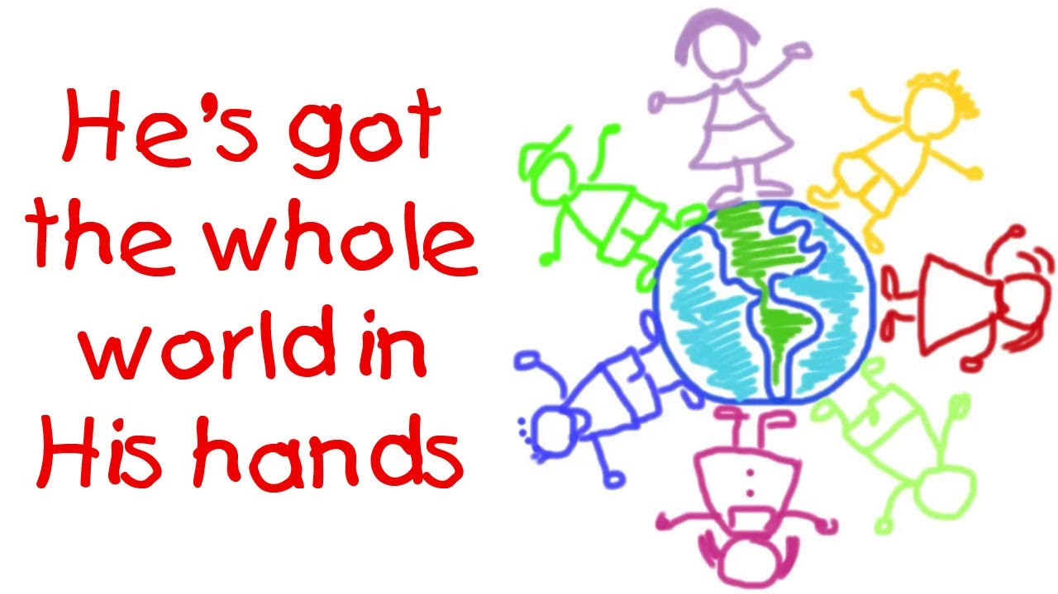

Slide 2
Got : có
Whole:toàn bộ
World: thế giới
Hands:tay

Slide 3
Daddy Dad
Mommy Mom
Brother : anh
Sister :chị
Younger Brother : em trai
Younger Sister : em gái

Slide 4
Little: nhỏ
Tiny: tí hon
Babies: những đứa bé
Baby: em bé

Slide 5
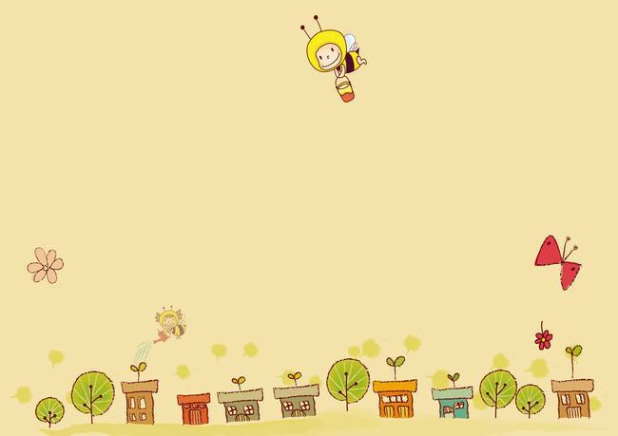
He's got the whole world in His hands
He's got the whole world in His hands
He's got the whole world in His hands
He's got the whole world in His hands.

Slide 6

He's got you and me, daddy in His hands
He's got you and me, daddy in His hands
He's got you and me, daddy in His hands
He's got the whole world in His hands.

Slide 7

He's got you and me, mommy in His hands,
He's got you and me, mommy in His hands,
He's got you and me, mommy in His hands,
He's got the whole world in His hands.

Slide 8
He's got you and me, brother in His hands
He's got you and me, brother in His hands
He's got you and me, brother in His hands
He's got the whole world in His hands.

Slide 9
He's got you and me, sister in His hands,
He's got you and me, sister in His hands,
He's got you and me, sister in His hands,
He's got the whole world in His hands.

Slide 10
He's got the little tiny babies in His hands,
He's got the little tiny babies in His hands,
He's got the little tiny babies in His hands,
He's got the whole world in His hands.

Slide 11


